Slide 1
Attention & Transformers

Slide 2
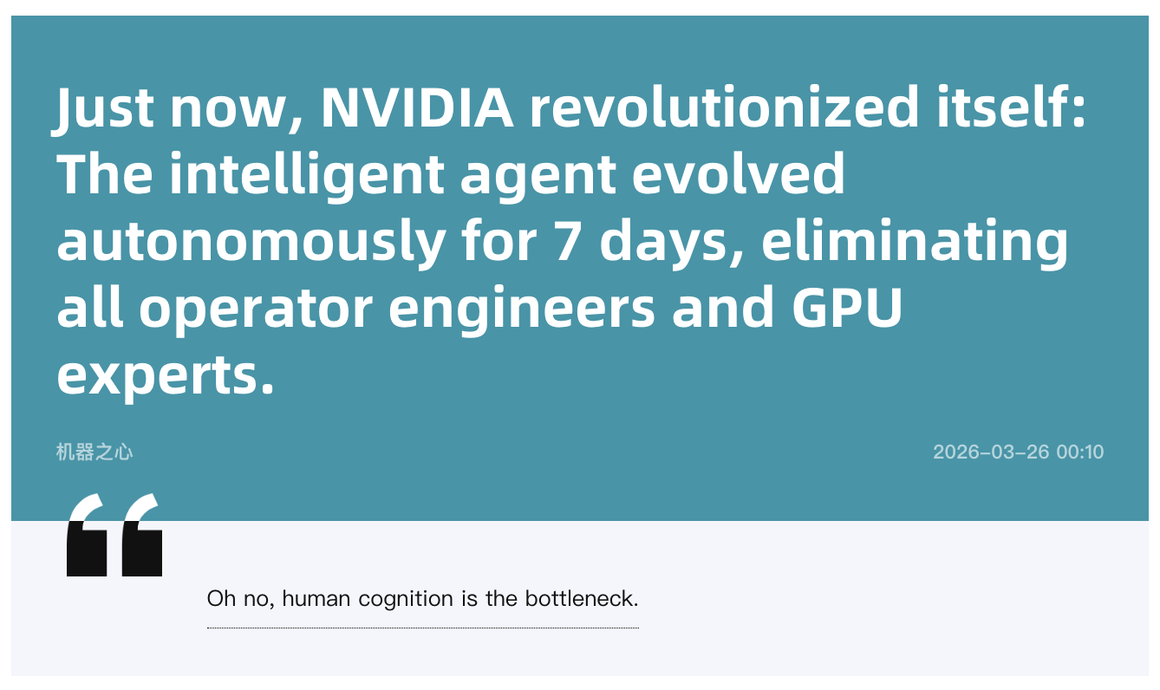

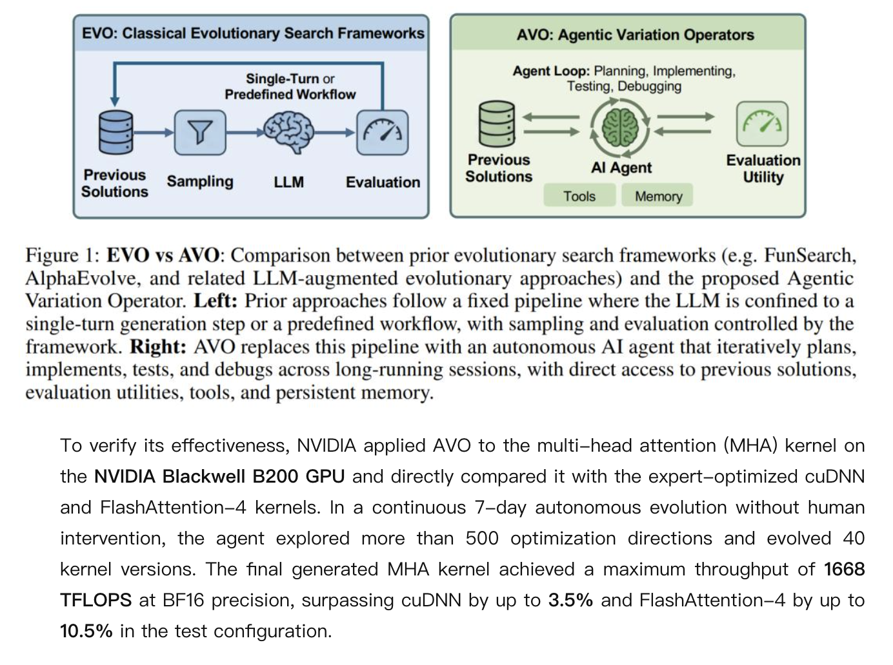
What’s In the News?

Slide 3

This Session’s Agenda
Attention Mechanism in RNNs for Translation (2014)
Sequence-to-sequence models with attention in translation tasks.
Scaled Dot Product Attention
Hard-code a rule for determining semantic similarity between a focal token and all other tokens in the sequence
QKV Framework & Multi-head Attention
We can incorporate trainable weights around the attention mechanism.

Slide 4
TF-IDF is “Static Attention”
Not all phrases are of equal importance…
E.g., David less important than Beckham
If a term occurs all the time, observing its presence is less informative
Inverse-document frequency (IDF) helps address this.
Term ‘weighting’ is then calculated as Term Frequency (TF) x IDF
n_{j}= # of docs containing the term, N = total # of docs
A term is deemed important if it has a high TF and/or a high IDF.
As TF goes up, the word is more common generally. As IDF goes up, it means very few documents contain this term.

Slide 5
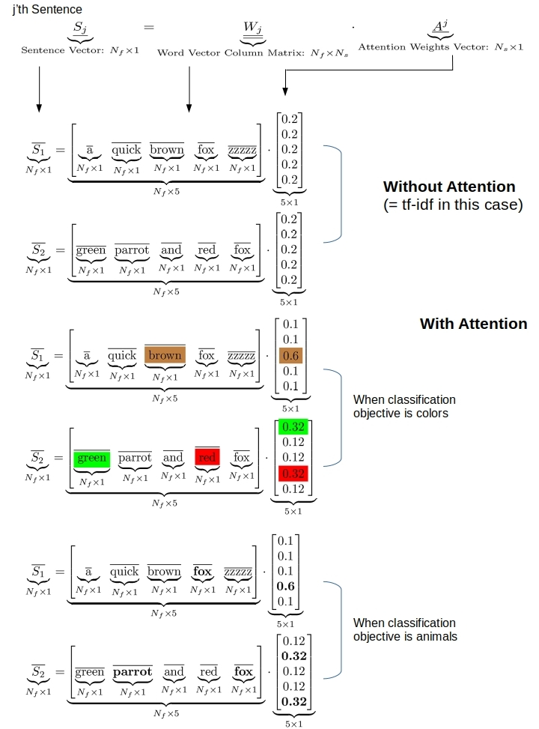
What Would Adaptive Weights Look Like?
Figure Out Weights Useful for Prediction
Rather than telling the network the weights, which is what TF-IDF effectively does, we provide the network a weight matrix to update!
This Yields Task-specific Token Weights
See some simple examples on the right.
Our network may learn that certain tokens are more important for predicting a given label.

Slide 6
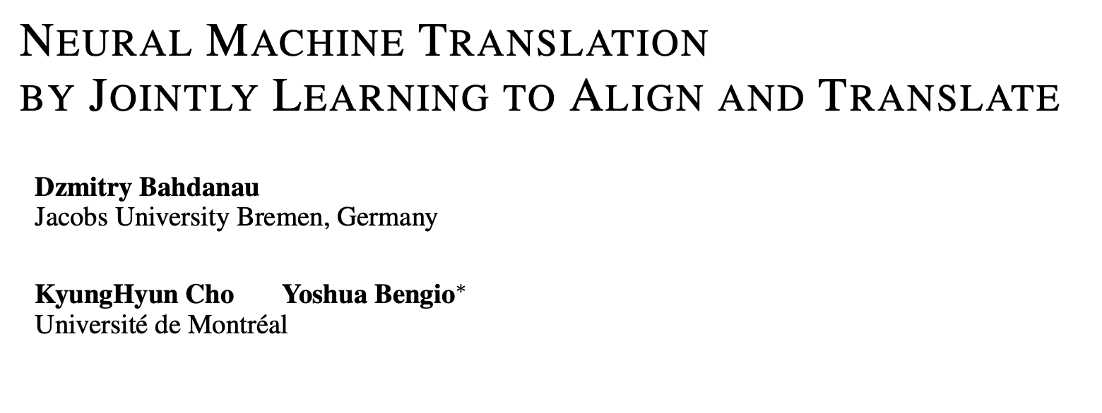
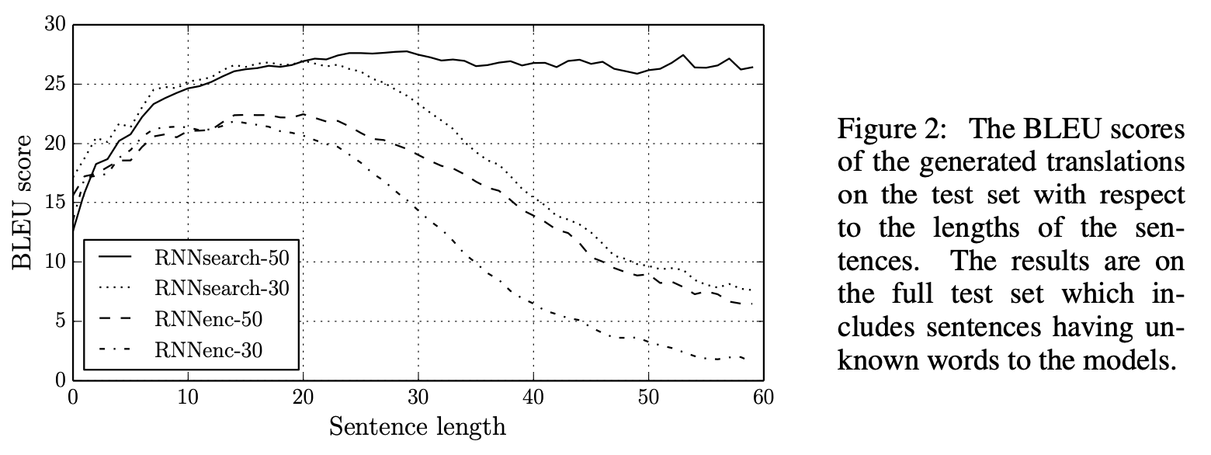
The First (RNN) Attention Model
“ … allowing a model to automatically (soft-)search for parts of a source sentence that are relevant to predicting a target word …”
Notes:
The challenge here in seq2seq models is to compress all of the input information into a single hidden state, to then enable output generation.

Slide 7
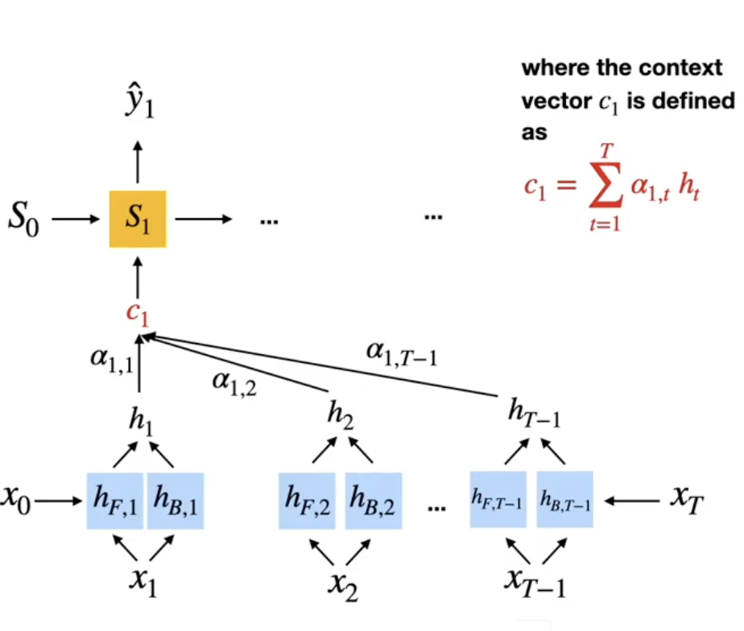
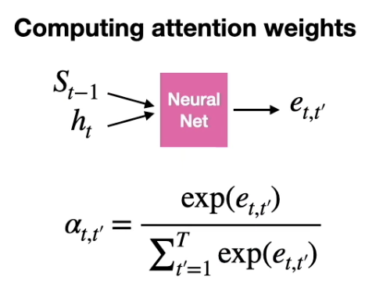

Bahdanau (2014) Attention
Step by Step
1. Encode: A bidirectional RNN processes the full input sequence, producing a hidden state at every position.
2. Score: At each decoding step, compare the decoder’s current hidden state to each encoder hidden state (S_t-1 vs. h’s) . This produces a relevance score per input token.
3. Attention Weights: Softmax the scores (they sum to 1).
4. Context: Weighted sum of scaled encoder hidden states. This vector tells the decoder what’s relevant from the rest of the sequence for the current output token.
5. Predict: Concatenate context vector with decoder hidden state → predict next output token.
Notes:
HOW ATTENTION SCORES ARE COMPUTED:
The bidirectional encoder produces hidden states h1...hN for the input. At each decoder step t, the decoder has its own hidden state s_t.
The score for input position j is computed by a small learned network: score_j = V * tanh(W1 * s_t + W2 * h_j). This is just a tiny Dense layer that takes two vectors (decoder state + encoder state) and outputs a single number representing 'how relevant is input position j to what I'm about to predict?'
Softmax these scores across all input positions to get attention weights (sum to 1). Weighted sum of encoder hidden states gives the context vector.
KEY INSIGHT: This lets the decoder 'look back' at any part of the input at any time, rather than relying on a single compressed vector. The attention weights are learned end-to-end during training.

Slide 8
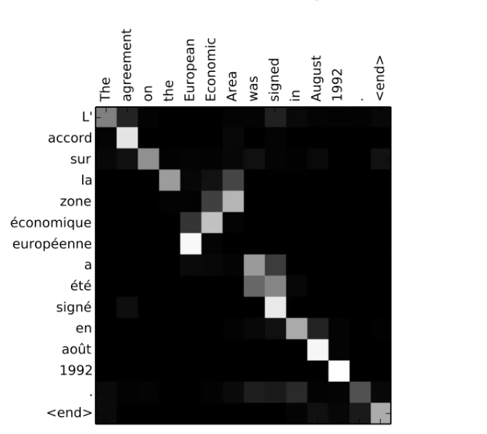
The First (RNN) Attention Model
Notes:
These are the attention scores that the model learns to assign to input tokens (words) across the entire input sequence when predicting a given output token (word) in the output sequence.
Strong diagonal alone means one-to-one translation of terms works okay, but in several cases we see that the the model pays attention to many other words when deciding how to translate a term… for example, when translating L’ it looks at both “The” and “signed” and “agreement.”

Slide 9
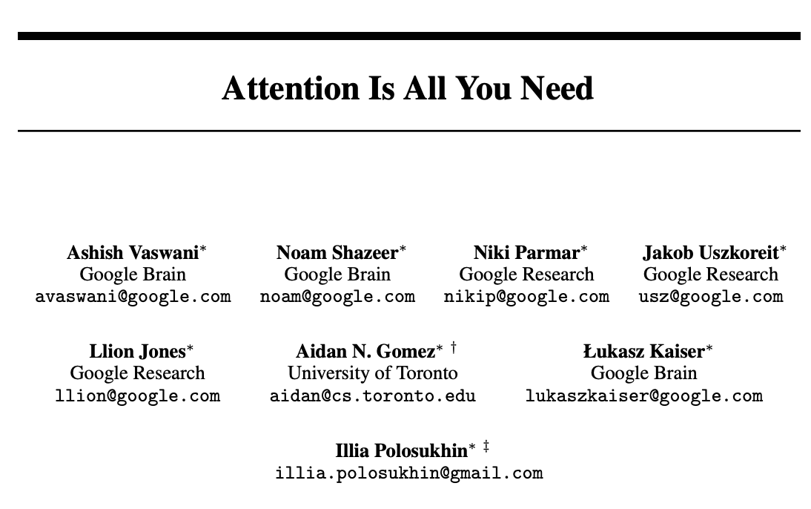
We Don’t Need an RNN for This!
We Can Drop the RNN and Process the Whole Sequence in Parallel
Note that transformers work with a similar encoder architecture, but no LSTMs are needed (we use ”stacked attention layers”).
Transformers are more computationally expensive (more calculations required), but because we can parallelize them, they can be trained faster than RNNs.
By moving away from RNN specific implementation we can also think about more general forms of attention (e.g.,. For CNNs).

Slide 10
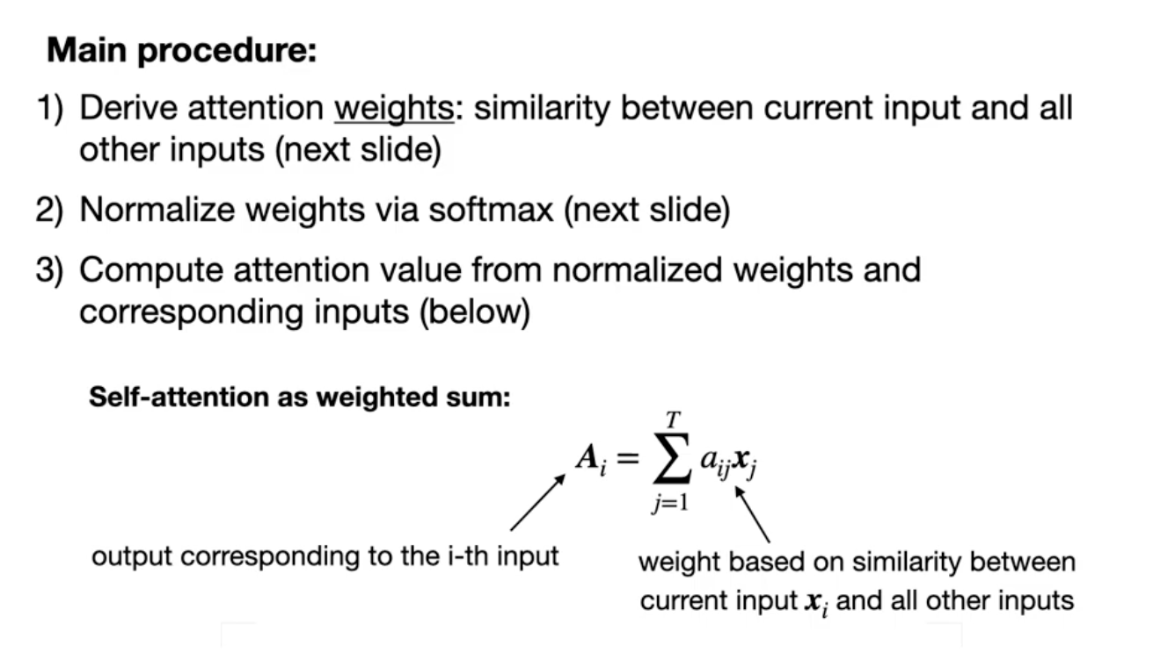
A Simpler (Less-Flexible) Attention Mechanism
Notes:
Here, A for word i is a weighted sum of all words in the sequence, indexed by j. The weights are based on how similar each other word in the sequence is to word i (e.g., based on dot-product). If we find that word I is very semantically similar to many other words in the sequence, we are going to give it a big A (it matters more). If word i is not related to all the other words, we give it a low A.
This is keras.layers.Attention(). It has no trainable weights inside!

Slide 11
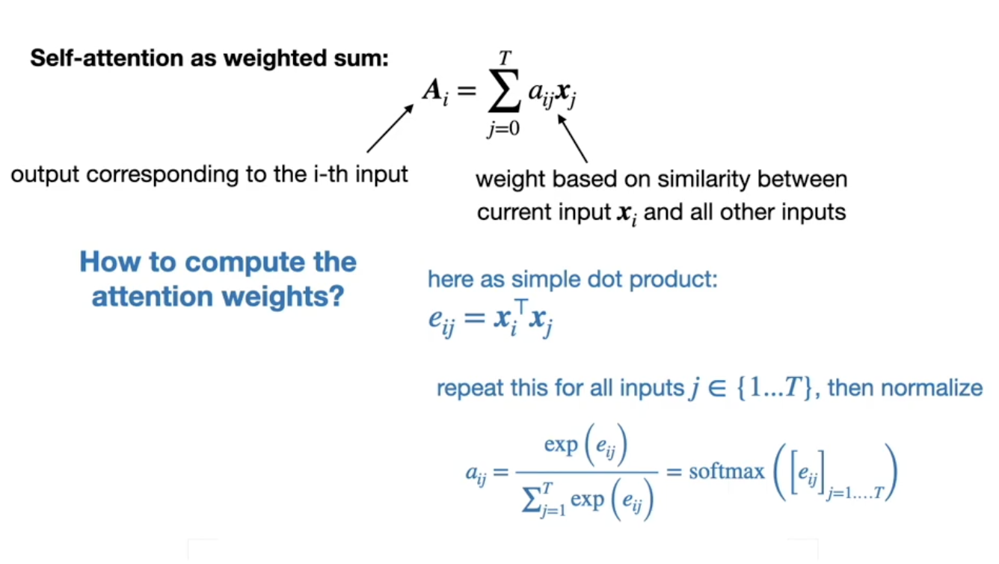
A Simpler (Less-Flexible) Attention Mechanism
Notes:
Here, A for word i is a weighted sum of all words in the sequence, indexed by j. The weights are based on how similar each other word in the sequence is to word i (e.g., based on dot-product). If we find that word I is very semantically similar to many other words in the sequence, we are going to give it a big A (it matters more). If word i is not related to all the other words, we give it a low A.
For word i, we take all pairs with other words, j, and calculate their dot products (e). We then softmax the resulting vector of dot product values. This forces the weights to sum to 1, and all lie between 0 and 1.
Once we have the a_ij reflecting word i’s association to each other word, we can now multiply the weights by each word in the sequence and add them up to get big A (roughly interpreted as the importance of word i, or how much attention we should pay to word i.

Slide 12
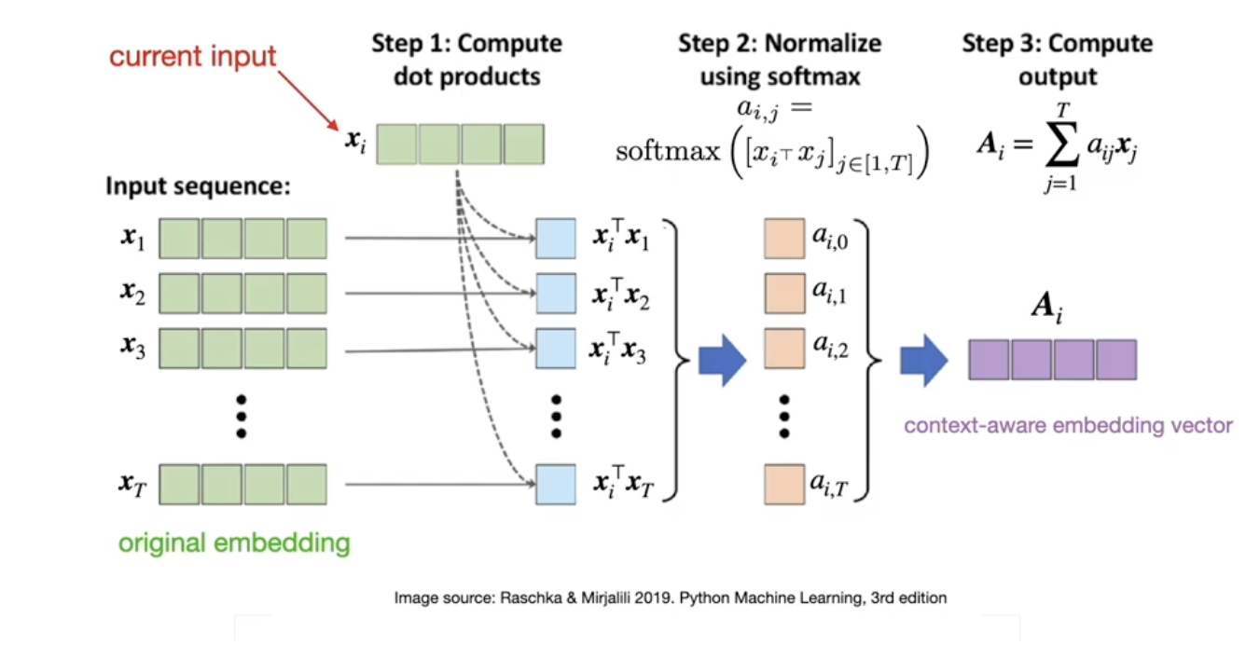
A Simpler (Less Flexible) Attention Mechanism
Notes:
Basically, what we end up with is a vector of A values (one for each input), which we use to predict outputs. You can think about this as replacing term x_i with a context-aware version of x_i. It’s like, forget about x_i, let’s think about an embedding which is a combination of all the words in the sequence (including term x_i) that collectively relate to the concept that word x_i captures. We are looking over the entire input set and adjusting each input token based on what is happening elsewhere in the input set that is relevant to the input token.
Some notes…
x_i is a vector (embedding).
x_i dot x_j is a scalar
a_i,j is the softmax of those various dot products, and each output is again a scalar.
A_i = sumprod(a_i,j and x_j) which is a vector because we sum over only one axis (if we have an 8D embedding to start, we sum over the 8 Ds, and get an 8D context-adjusted embedding.
for x_i we are left with one A_i (the adjusted version of x_i.

Slide 13
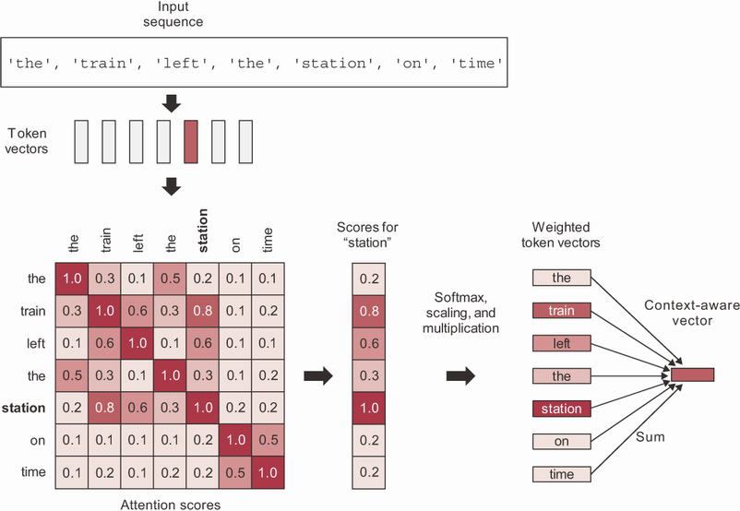
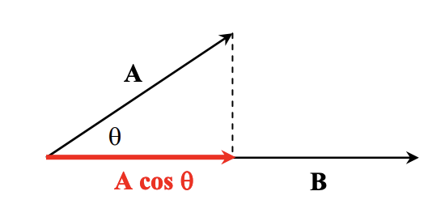
keras.layers.Attention()
Basic Self-Attention
This is what the textbook introduces.
We ‘shift’ each input word embedding (vector representation) toward other words in the input that are most similar (smallest cosine distance).
This ‘contextualizes’ each word embedding, changing its representation depending on the other words that appear alongside it.

Slide 14
This Attention Mechanism is ‘Rigid’
The Approach Considers the Input Context in a ‘Fixed’ Manner
Although it doesn’t assume forward or backward sequence/ordering is most important (like an RNN does), it does assume a specific attention rule. Notice the approach does not use any weights! The network cannot ‘learn’ how it should decide which tokens to attend to in a context.
We get context-specific attention weights, but the notion of how context is processed is pre-defined / hard-coded in the dot-product-summation procedure; there is no way to ‘adjust’ or ’adapt’ this attention rule.
This pre-defined approach to attention also might not generalize well outside of language. The pre-defined approach to attention assumes that shared semantic similarity is the best heuristic for attention, but perhaps it is not in some cases. Most obviously, perhaps in some scenarios it is ideal to focus attention on words that are semantically dissimilar.
How can we enable a procedure of this sort, but injecting trainable parameters, so the network can figure out an optimal attention rule during training?

Slide 15
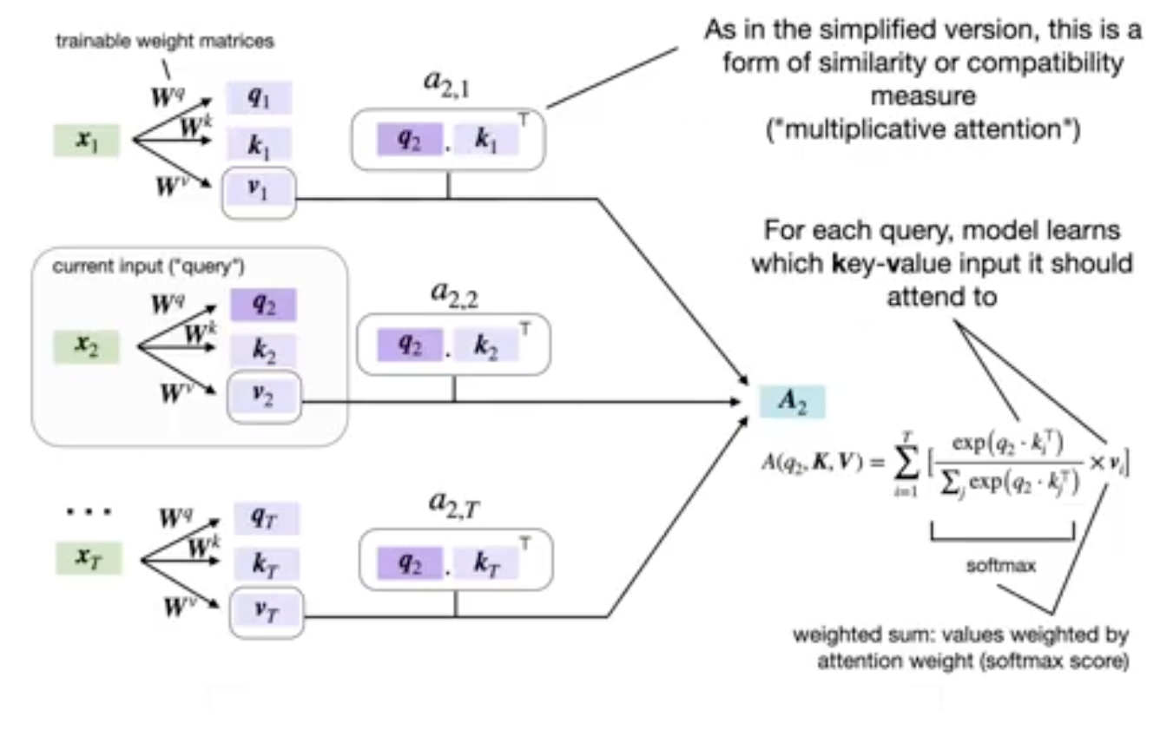
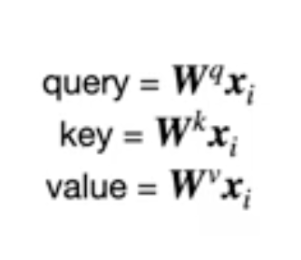
Query Key Value (QKV) Framework
We Add Some Weight Matrices!
We begin by taking an input embedding (e.g., a word embedding) and we multiply it by a matrix of randomly initialized (but refined in training) weights.
The NN can learn how to ‘pre-transform’ the embeddings, thereby modifying the overall attention rule.
We learn to project the embedding into a ‘new latent space’ before doing our dot product comparisons, etc.
Notes:
Query, Key and Value comes from the idea of a database lookup.
Query, Key and Value are all weight-matrix multiplied versions of the original input sequence (of embeddings). Thus, rather than use the raw embedding and take its dot product with other raw embeddings, now we have trainable parameters that first apply possibly different transformations to the input embedding of the focal token, to the embeddings of the other tokens in the context, and we then incorporate the eventual attention-modified contextual embedding multiplicatively, with yet another weighted version of the original input embedding. The process is essentially the same as scaled dot-product, but now we have a whole bunch of trainable parameters that let us play with *what* we take the dot products of, and with how we integrate the the attention-weighted information into our prediction.

Slide 16

‘Scaled’ Dot Product
Scaled Dot-Product Attention…
One other nuance is that we scale the Softmax input.
This is done to prevent the dot products from getting too big, which can cause the output of softmax to tend toward 1 or 0 and lead to vanishing gradient issues.
sqrt(d_{k}) is the square root of the dimensionality of the input key embeddings (in the original paper, this was the same as the dimension of the word embeddings).
We write this in big-letter notation because we can parallelize everything as tensor calculations.
Notes:
Query, Key and Value comes from the idea of a database lookup.
Query, Key and Value are all weight-matrix multiplied versions of the original input sequence (of embeddings). Thus, rather than use the raw embedding and take its dot product with other raw embeddings, now we have trainable parameters that first apply possibly different transformations to the input embedding of the focal token, to the embeddings of the other tokens in the context, and we then incorporate the eventual attention-modified contextual embedding multiplicatively, with yet another weighted version of the original input embedding. The process is essentially the same as scaled dot-product, but now we have a whole bunch of trainable parameters that let us play with *what* we take the dot products of, and with how we integrate the the attention-weighted information into our prediction.

Slide 17
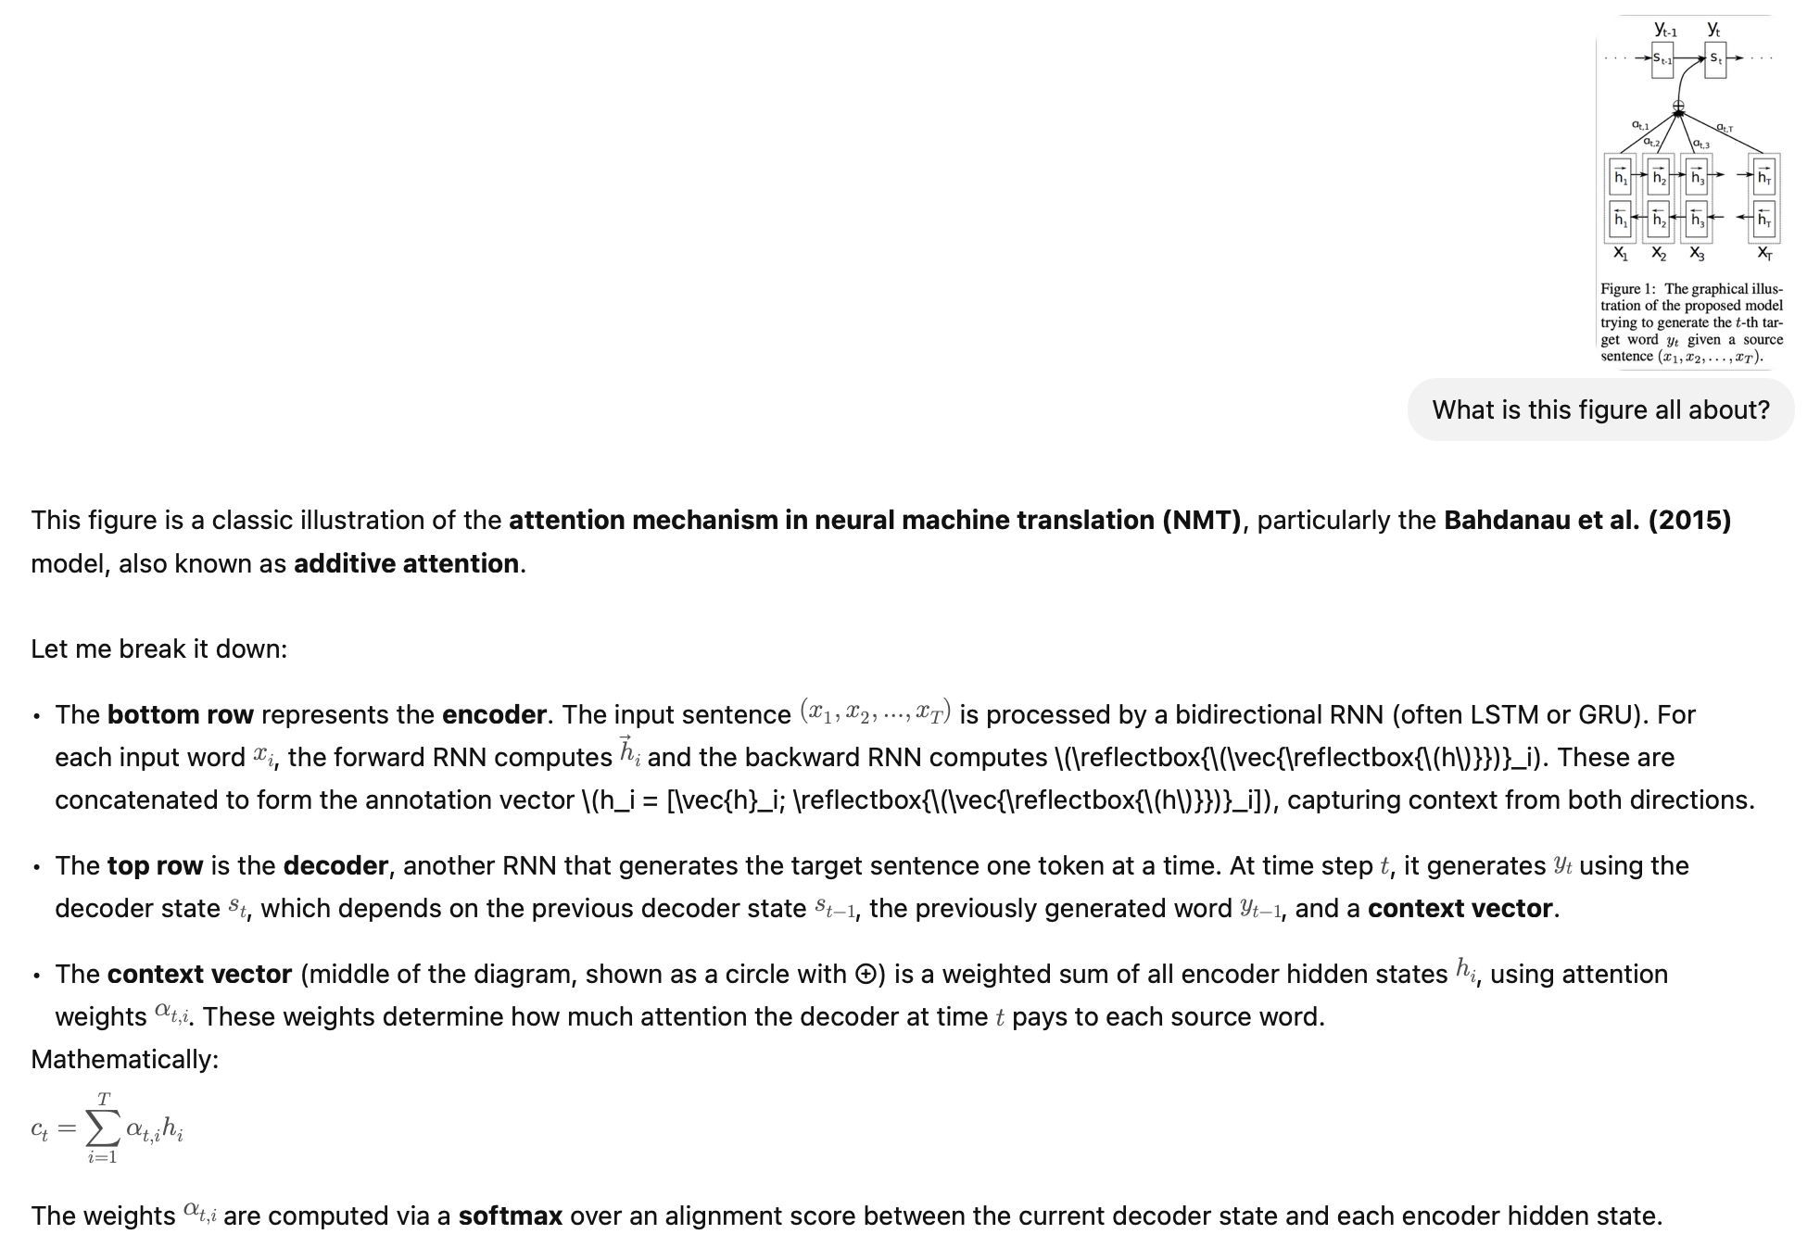
From Self-Attention to Cross-Attention
We now have the freedom to learn attention scores for input in one modality of input data to inform what we do with input in another modality. The dot product might be applied to compare a word embedding against a set of other document or image embeddings (this is what modern Retrieval Augmented Generation does!)
Example: Image Q&A
You input an image (e.g., via a CNN or ViT), then input a text prompt (e.g., for captioning or VQA).
Use cross-attention: the text tokens query the image features to decide what visual content is relevant before producing the textual response.

Slide 18
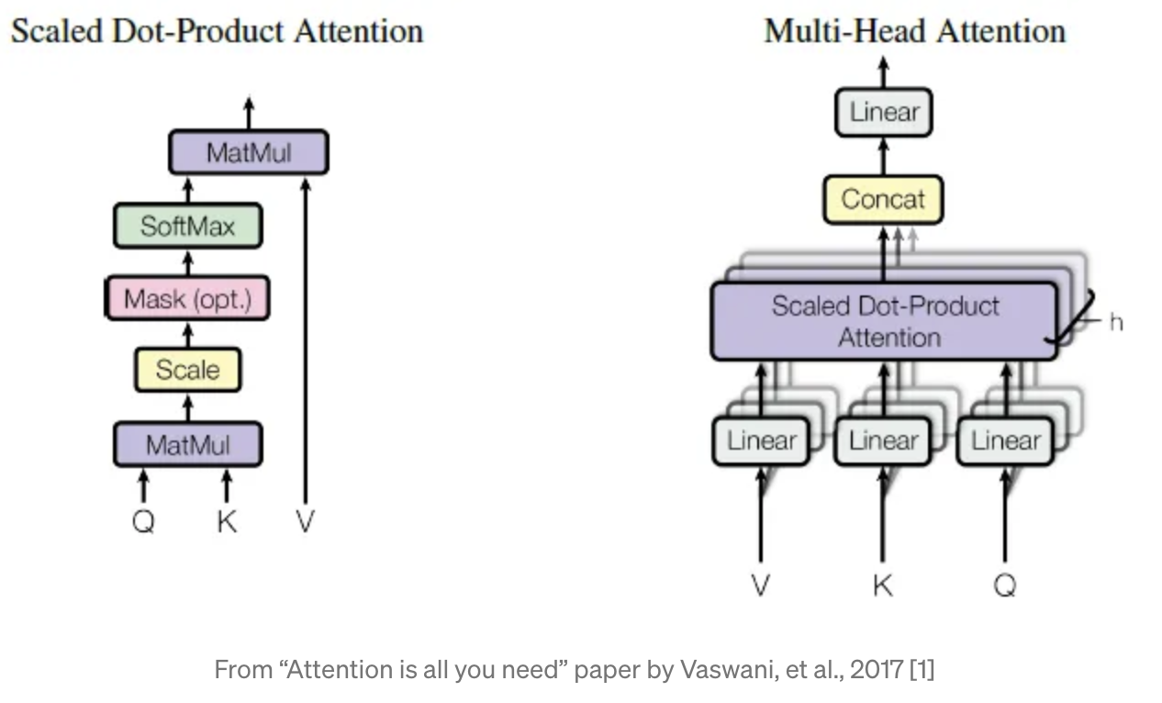
keras.layers.MultiHeadAttention()
We have Multiple ‘Heads’ Paying Attention in Different Ways
Each head can be attending to something very different.
By using multiple sets of query, key and value weight matrices, the network can learn to consider different combinations of input features.
This lets it capture more complex patterns in the data.

Slide 19
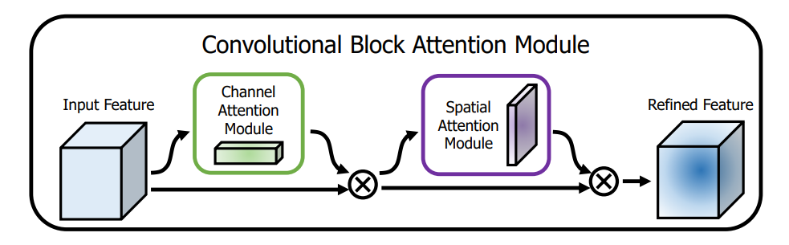
Attention is Not Just for Text
Spatial Attention
We chunk images spatially and implement an attention mechanism to allow a model to decide which portions of the image it should focus on.
Channel Attention
We implement an attention mechanism that allows the model to decide which feature maps are important for a given prediction task. You could, e.g., flatten each feature map into a vector and treat it just like word embeddings are handled in the QKV framework. You can similarly take ‘patches’ of input (like we do in pooling layers) and decide which to attend to in the same way.

Slide 20
Questions?
Notes:
Weights are not initialized until you “build” the model (or compile it, which will first build).

